Slide 1
Data 606 Capstone Analysis of Telecom CHURNDATA
LAXMI PRASANNA CHENNADI
(jg55734)

Slide 2
Recap
Telecom churn data includes various parameters that effect churn, where churn is number of Customers leaving the current company and moving to another.
Dataset comprises of 21 columns, which include state, account length, area code, phone number, international plan etc.
The main agenda is to know possible customers that might churn to other telecom network.
Source: https://www.kaggle.com/becksddf/churn-in-telecoms-dataset

Slide 3
Literature Review
Churn analysis is the evaluation usually done by the organization on the customer’s loss rate.
The organizations are very interested in analyzing these trends and use it to reduce churn rate as the price for acquiring a new customer is usually higher than retaining the old one.
According to the authors of “Leading on the Edge of Chaos”, a 2% increase in customer retention (or decreasing churn) is equivalent to 10% reduction in costs.

Slide 4
Exploratory Data Analysis
Analyzing the characteristics of data.
Defined Datatypes of various columns.
Performed Data Cleaning and removed null values.
Further analyzed the target column.
Examined the correlation between columns.
Evaluated factors effecting Target column.
Checked and removed the outliers.

Slide 5
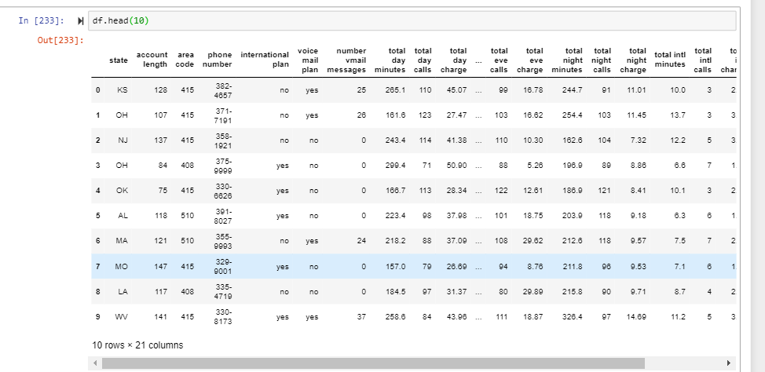
Preliminary Analysis

Slide 6
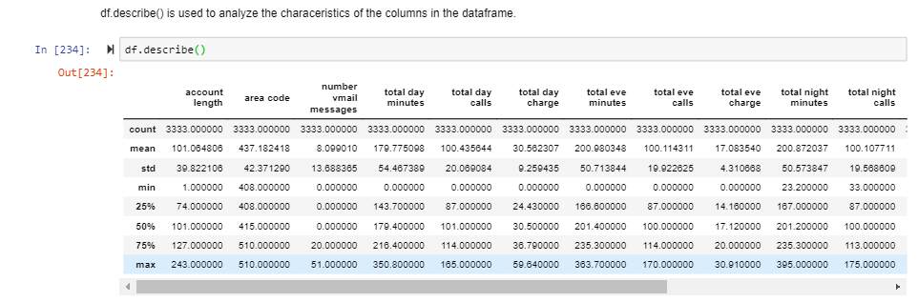

Slide 7
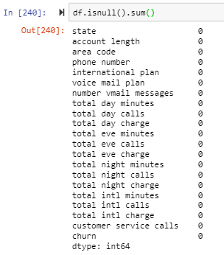
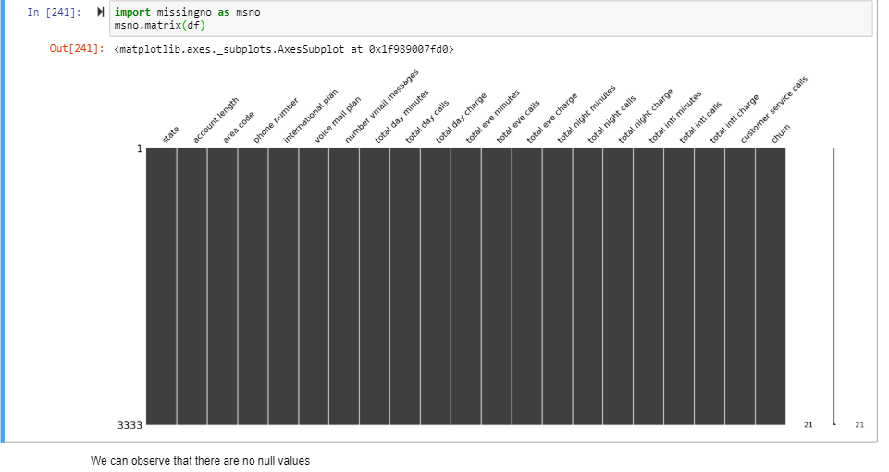
Data Cleaning
No Null values are observed

Slide 8
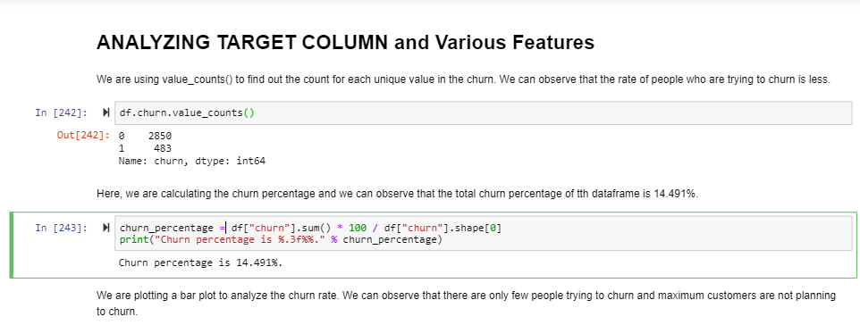
Target Column Analysis
The rate of churn is 14.49%.
It clearly depicts that data is imbalanced, which is to be considered while developing a model.
Notes:
It clearly depicts that data is imbalanced, which is to be considered while developing a model.

Slide 9
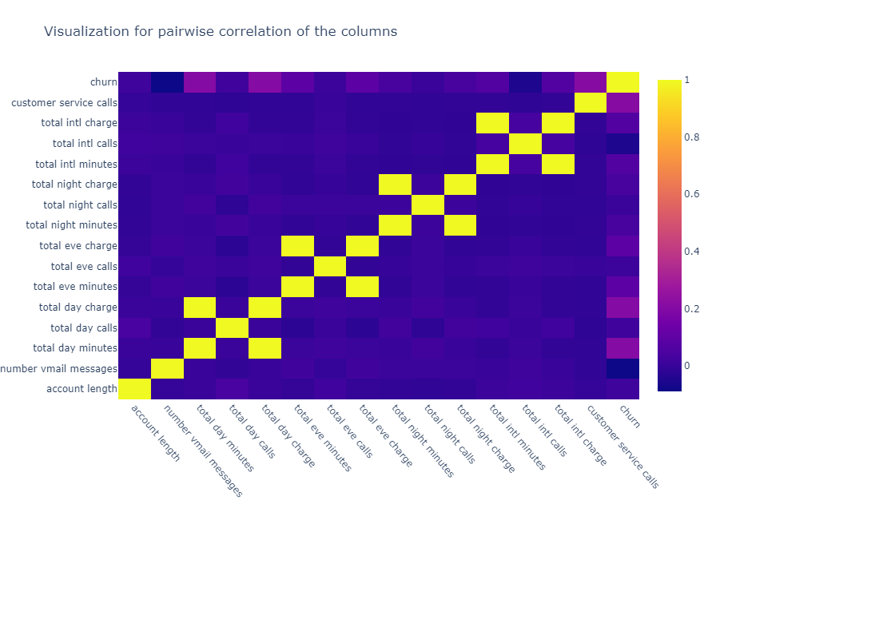
Correlation between columns
MULTICOLLINEAR VARIABLES :
Night Mins , Night Charge 0.999999
Eve Charge , Eve Mins 1.000000
Day Charge , Day Mins 1.000000
Intl Charge , Intl Mins 0.999993
The columns that have highest correlation with the churn variable are the total day charge, the total day minutes and the number of customer service calls.

Slide 10
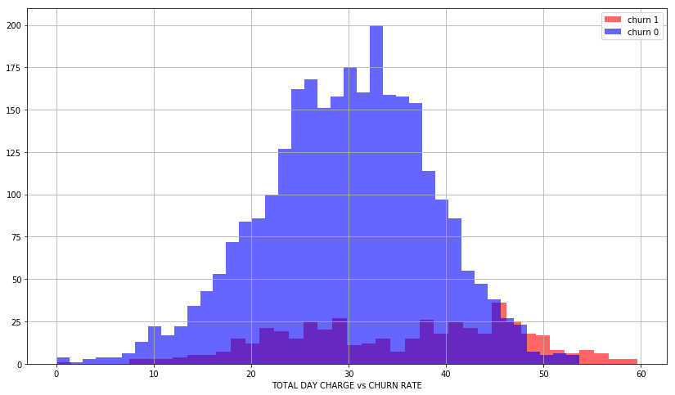
Factors Effecting Churn
As day charge increases, rate of churn is also increasing

Slide 11
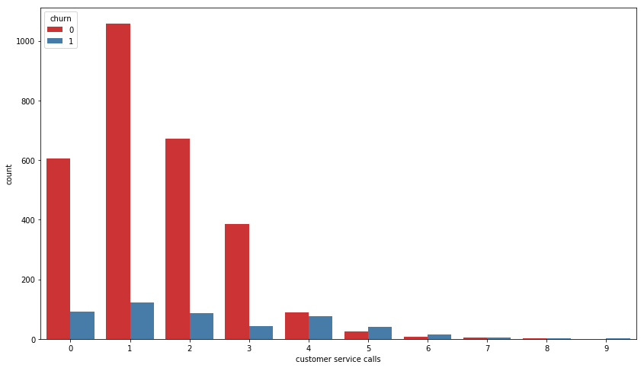
churn is directly proportional to customer service calls.

Slide 12
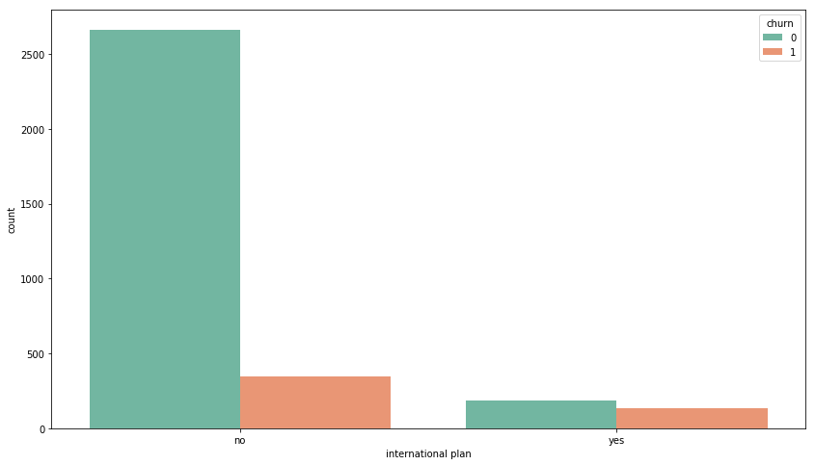
churn rate is high for customers with international plan when compared to customers with no international plan.

Slide 13
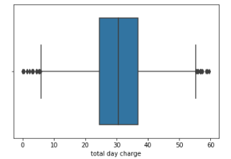
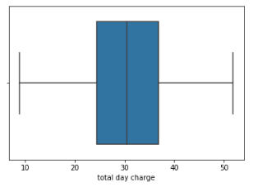
Outliers

Slide 14
References:
https://www.researchgate.net/publication/321723500_Review_of_Customer_Churn_Analysis_Studies_in_Telecommunications_Industry
https://towardsdatascience.com/machine-learning-powered-churn-analysis-for-modern-day-business-leaders-ad2177e1cb0d
https://journalofbigdata.springeropen.com/articles/10.1186/s40537-019-0191-6
http://www.computerscijournal.org/vol10no1/churn-analysis-in-telecommunication-using-logistic-regression/

Slide 15
Next Step
Model Building
Choosing the best fit Model

Slide 16
QUESTIONS…

